Slide 1
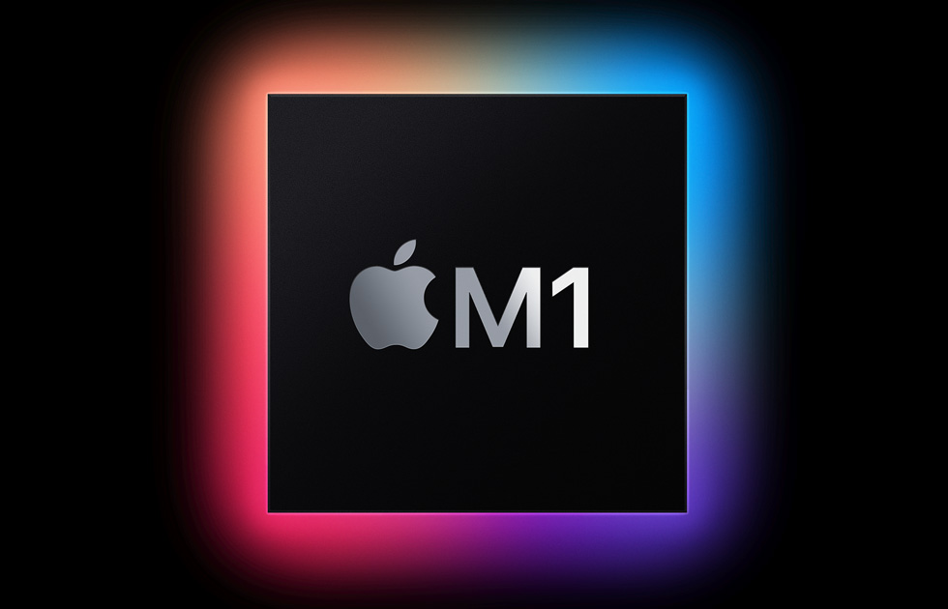

Slide 2
Apple M1 Chips
Cupertino, California — Apple today announced M1, the most powerful chip it has ever created and the first chip designed specifically for the Mac. M1 is optimized for Mac systems in which small size and power efficiency are critically important.

Slide 3
As a system on a chip (SoC), M1 combines numerous powerful technologies into a single chip, and features a unified memory architecture for dramatic
As a result, M1 delivers up to 3.5x faster CPU performance, up to 6x faster GPU performance, and up to 15x faster machine learning, all while enabling battery life up to 2x longer than previous-generation Macs. With its profound increase in performance and efficiency, M1 delivers the biggest leap ever for the Mac.ally improved performance and efficiency.

Slide 4
“There has never been a chip like M1, our breakthrough SoC for the Mac. It builds on more than a decade of designing industry-leading chips for iPhone, iPad, and Apple Watch, and ushers in a whole new era for the Mac,” said Johny Srouji, Apple’s senior vice president of Hardware Technologies. “When it comes to low-power silicon, M1 has the world’s fastest CPU core, the world’s fastest integrated graphics in a personal computer, and the amazing machine learning performance of the Apple Neural Engine.

Slide 5
First System on a Chip for the Mac
Macs and PCs have traditionally used multiple chips for the CPU, I/O, security, and more. Now with M1, these technologies are combined into a single SoC, delivering a whole new level of integration for greater performance and power efficiency. M1 also features a unified memory architecture that brings together high-bandwidth, low-latency memory into a single pool within a custom package. This allows all of the technologies in the SoC to access the same data without copying it between multiple pools of memory, further improving performance and efficiency.

Slide 6
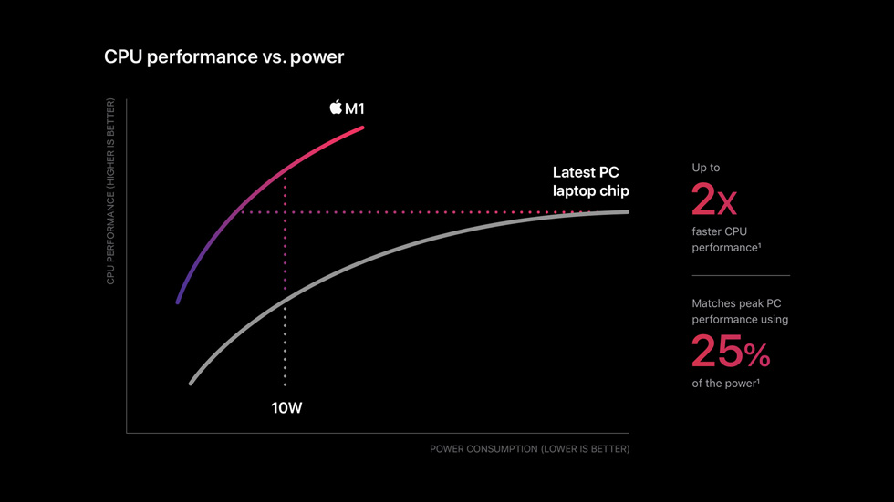
CPU performance vs. Power

Slide 7
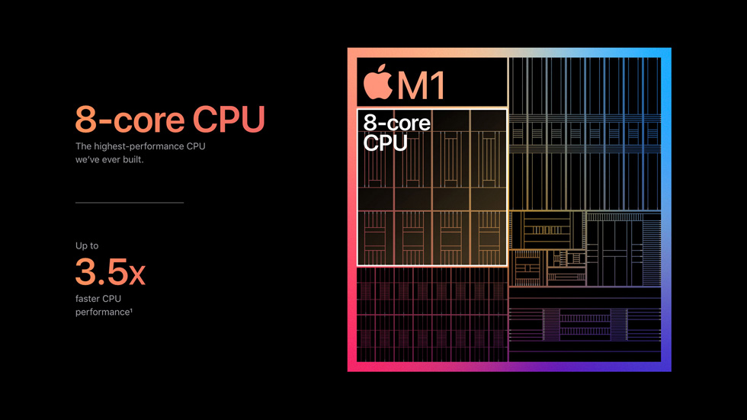
The World’s Best CPU Performance per Watt
M1 features an 8-core CPU consisting of four high-performance cores and four high-efficiency cores. Each of the high-performance cores provides industry-leading performance for single-threaded tasks, while running as efficiently as possible. They are the world’s fastest CPU cores in low-power silicon, allowing photographers to edit high-resolution photos with lightning speed and developers to build apps nearly 3x faster than before. And all four can be used together for a huge boost in multithreaded performance.

Slide 8
The four high-efficiency cores deliver outstanding performance at a tenth of the power. By themselves, these four cores deliver similar performance as the current-generation, dual-core MacBook Air at much lower power. They are the most efficient way to run lightweight, everyday tasks like checking email or browsing the web, and preserve battery life like never before. And all eight cores can work together to provide incredible compute power for the most demanding tasks and deliver the world’s best CPU performance per watt.

Slide 9


